Slide 1
Android Architecture

Slide 2
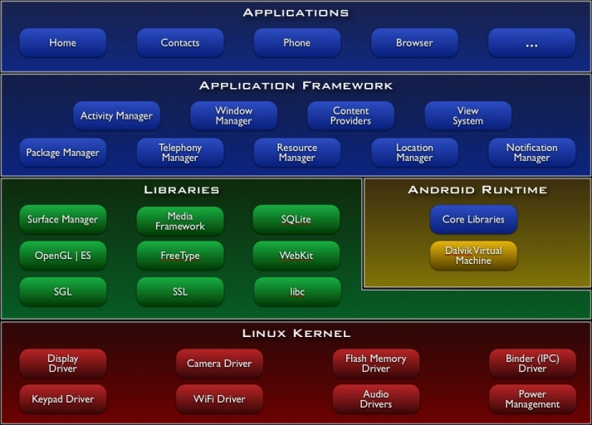
Android Operating System

Slide 3
Android OS Components
Linux Kernal
Native Libraries
Android Runtime
Application Framework
Applications

Slide 4
Linux Kernal
Exists at the root of the android architecture
Responsible:
1) Device drivers
2) Power management
3) Memory management
4) Device Access

Slide 5
Native Libraries
Placed on top of the Linux kernal
Examples:
1) WebKit – browser support
2) Sqlite – database connectivity
3) Media – playing and recording audio

Slide 6
Android Runtime
Set of core libraries and DVM which enable Android developers to develop applications using standard Java programming language.
Responsible is to run android applications.
Consumes less memory and fast performance.

Slide 7
Application Framework
Includes Android API such as UI, telephony, resources, locations
Provides lot of classes and interfaces for developing android applications.

Slide 8
Android Core Building Blocks
Activity
Views
Intents
Content Providers
Services
Fragments
AndroidManifest.xml

Slide 9
Intent
Intent is used to invoke components.
Usage:
Start the service
Launch an activity
Display a web page
Display a list of contacts
Broadcast a message
Dial a phone call etc.

Slide 10
Service
background process that can run for a long time.
Types of Service:
1) Local Service
2) Remote Service

Slide 11
Content Providers:
- Share data between the applications
Fragment:
- Part of activity
- An activity can display one or more fragments on the screen at the same time.
AndroidManifest.xml:
- Contains info about activities, content providers, permissions etc..

Slide 12
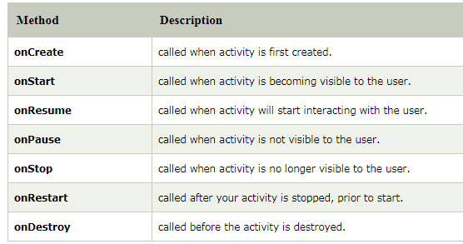
Activity Lifecycle Methods

Slide 13
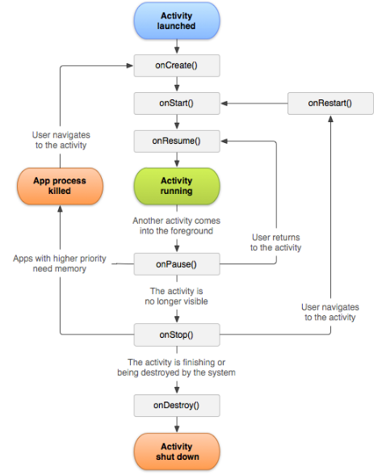
Activity Lifecycle

